Slide 1




Welcome to our detective agency
Based on the concept of caesar cipher.

Slide 2

DETECTIVE SQUAD
1
JITISHA ADWANI
2
TANEESHA MATHUR
3
BHAKTI YADAV
4
SAKSHI SINGHVI
We help in encrypting and decrypting the secret messages sent acrossed.
5
MEHAK RUSTAGI

Slide 3
YOU WANT TO KNOW HOW WE WORK,RIGHT?
Cryptography is the study of writing or solving secret codes that are used for secure communication.Now cryptography is essential in computer science for keeping everything from e-mails to bank account information secure.The Caesar cipher, named after Roman Emperor Julius Caesar is one of the earliest and most widely known ciphers. It is a simple form of a “substitution cipher” where you replace each letter of the alphabet with another letter by shifting the whole alphabet a certain number of letters (wrapping around to the beginning once you reach the end). For example, this would be your key and code if you shift each letter by three spaces:
Plain: ABCDEFGHIJKLMNOPQRSTUVWXYZ
Cipher: XYZABCDEFGHIJKLMNOPQRSTUVW
So, when you write your message, the letter A gets replaced with X, B gets replaced with Y and so on.
In order to decode your message, you need to share the “key” (the number 3 here) with the other person. After that you can send messages that are written in cipher so other people can't read them!

Slide 4
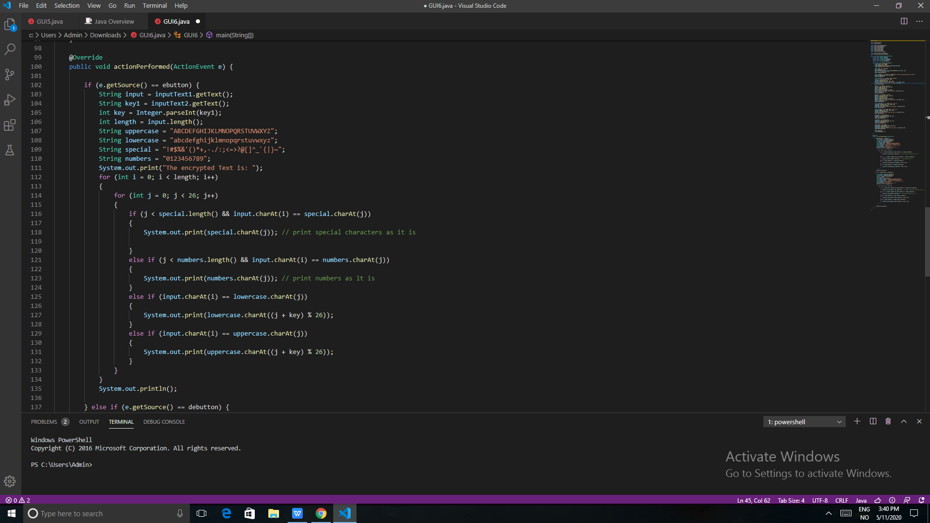

LET'S ENCRYPT

Slide 5
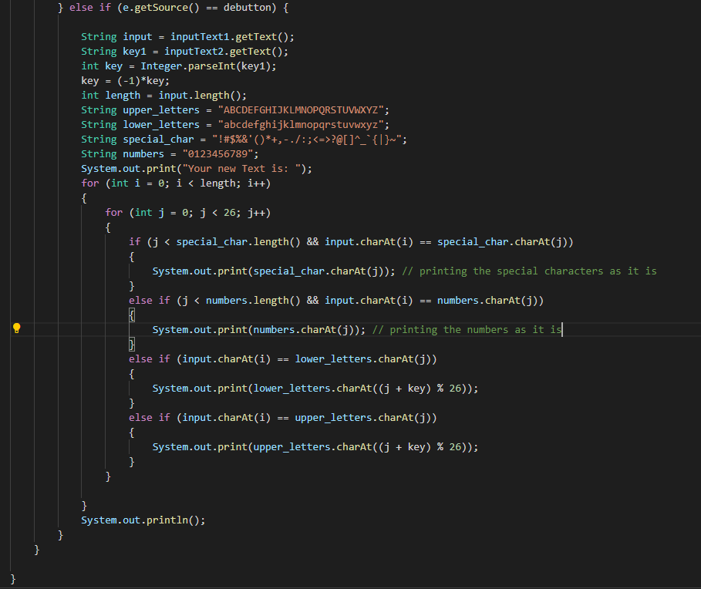

DECRYPT

Slide 6
HOW DOES THE CODE WORK?
Encryption
Plain Text
The key added is iterated through the input text.
Each alphabets is mapped to the key and shifts accordingly to obtain cipher text.
Enter the plain text which has to be encrypted.
Enter an integer for the shift of characters with the use of Key.
02
01
03
Cipher Text
04
To decrypt the cipher text, enter the key.
The decryption process follows the same algorithm but in reverse.
Decryption
The code subtracts the key from the obtained cipher text.
Cipher text changes to Plain text.

Slide 7
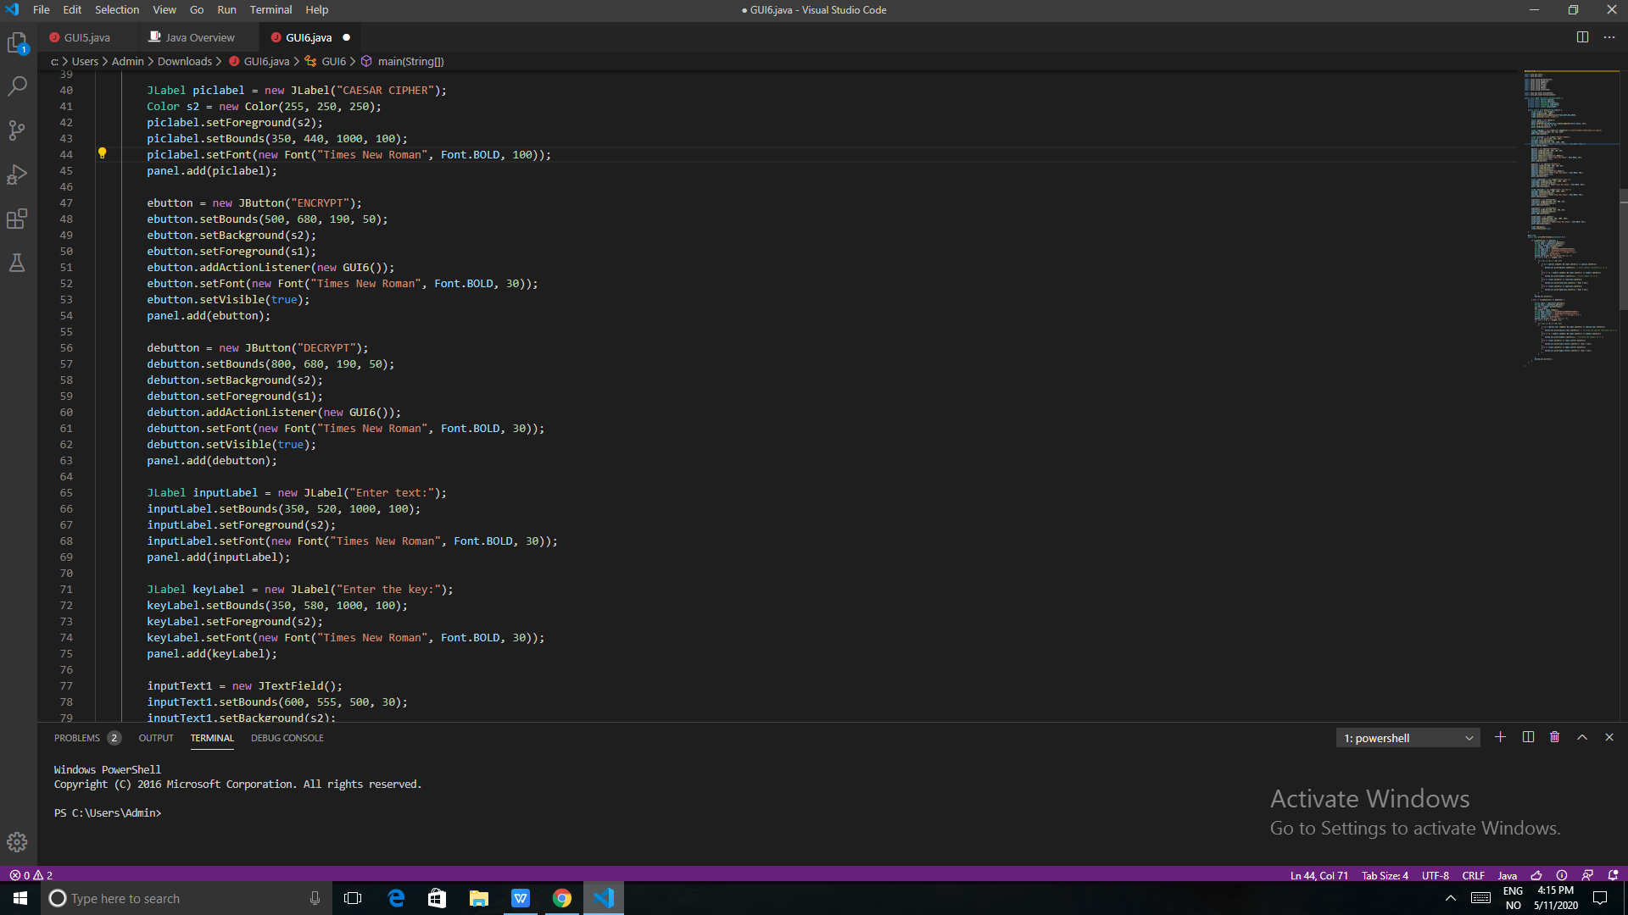
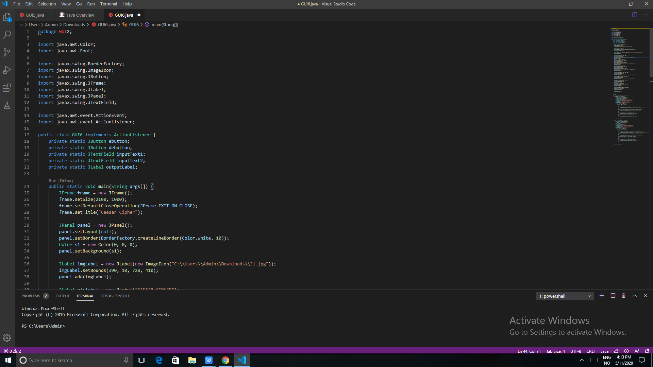
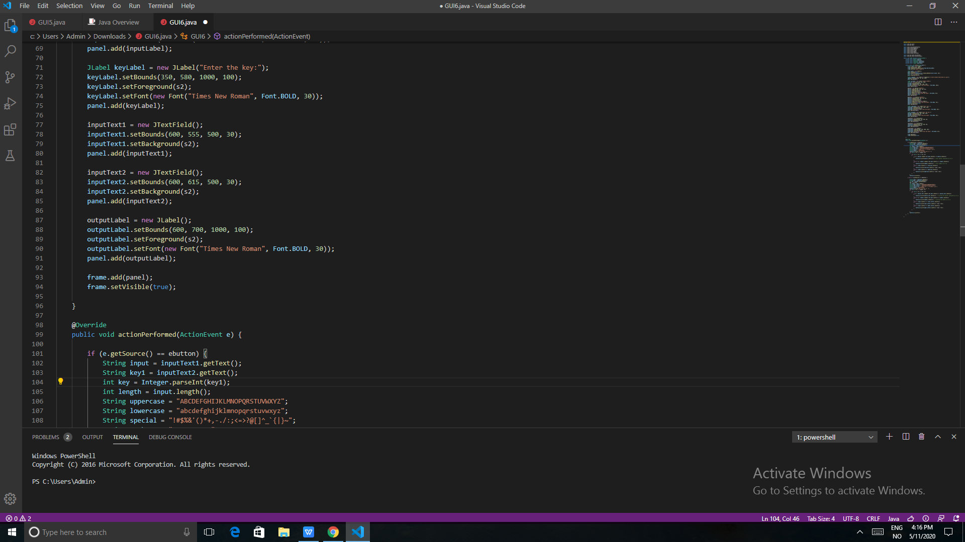
LET'S STYLE IT TO MAKE IT MORE INTERESTING!

Slide 8
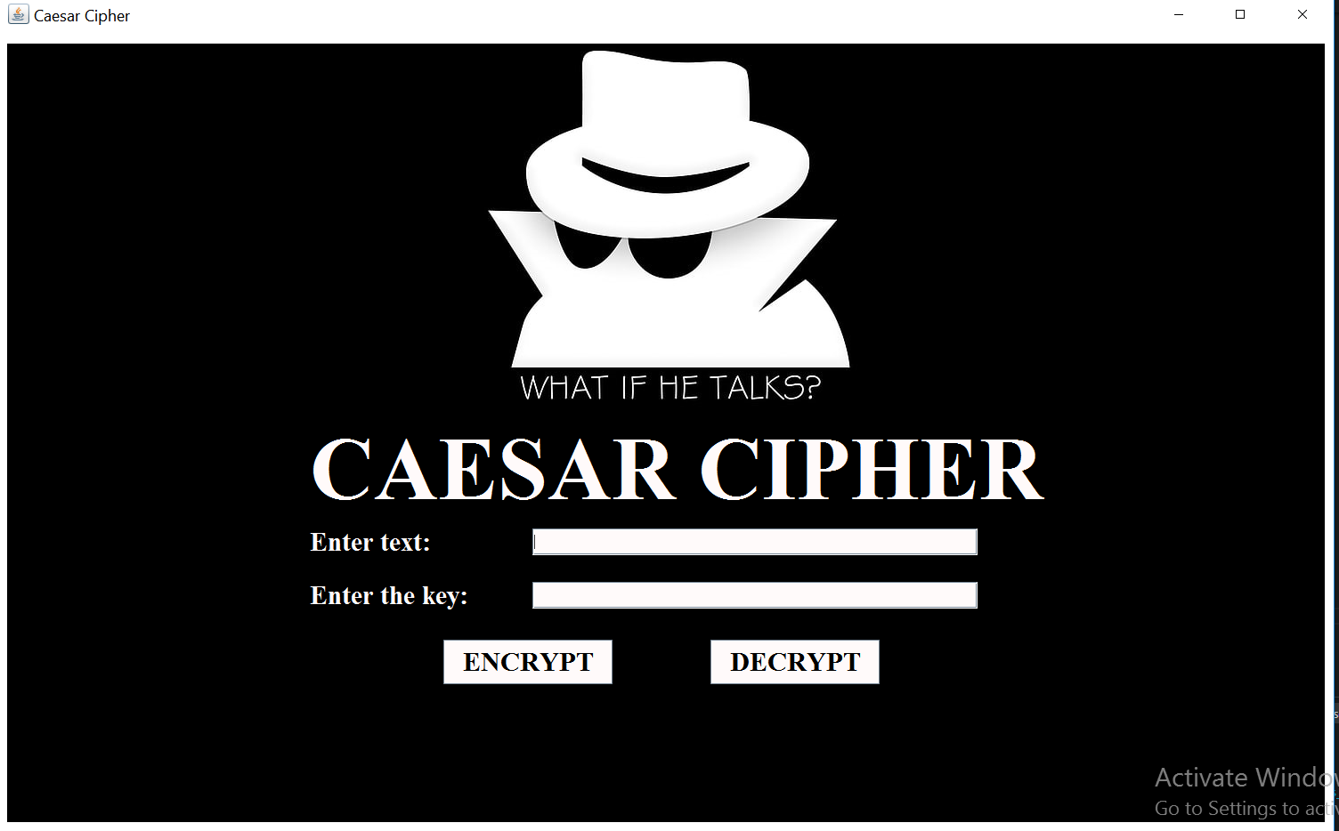
OUTPUT WINDOW

Slide 9

NOW LET'S GET BACK AND UNDERSTAND WHAT WE DID.
1.Declare variables private static so that they become class variables.
2. Make a JFrame window which includes panelwhich is made to include several panels,buttons etc.
3.Use different methods like setBackground, setForeground to style your frame.
4.Add title.
5.Add image through ImageIcon method, add image into the panel.Set path correctly and add dimensions.
6. Similiarly add buttons, labels, Text fields and set their attributes.
7. After completing the panel, add the panel to the frame and make setVisible(true) so that the output window appears on the screen.

Slide 10

1. Complete Data Protection
A complete encryption solution provides businesses and their owners with peace of mind because it protects data in all states – at rest and in transit. With the right encryption solution, you can go through each day knowing that your data is safe and that there is no reasonable way in which hackers could potentially get their hands on the raw data.
SCOPE
2. Security Across Multiple Devices
Data encryption software will allow you to ensure that all data, across any device, is completely encrypted with the same protections in place that you would find in data stored on a desktop computer. Data encryption will help to take an untenable, stressful situation and make it manageable, while providing peace of mind.
3. Integrity Maintained
Another way for hackers to commit data fraud is to knowingly alter the data that is available. Encryption keeps your data safe from alterations, and recipients of the data will be able to see if it has been tampered with. Alteration of data is something that many businesses often overlook when they are looking into ways to keep their data safe.
4. Ensure Compliance
Compliance is extremely important, and many IT departments must comply with legal, insurance and industry restrictions on how data can be handled and transmitted. Encryption provides one of the safest ways for a business to transmit and store data and comply with the restrictions that your business currently has in place such as FIPS, FISMA, HIPAA, PCI/DSS or Gramm-Leach Bliley.

Slide 11
Came on the same page from where you started? Well, this is what encryption decryption is all about.
HOPE YOU HIRE US SUPER
SOON.
THANK YOU!

